Slide 1


October 5, 2026
PROPOSAL
VERIZON
Ethics and Marketing Review
“We power and empower how people live, work and play”
BUMK760
Team 4: Heven Abraha, Nia Bishop, Rutendo Nyoka and Julia See

Slide 2


COMMITMENT TO UN SUSTAINABLE DEVELOPMENT GOALS
SDG TARGETS AND PROGRESS
04
QUALITY EDUCATION
  Target: By 2030, significantly increase the number of young people and adults with relevant technical and vocational skills to secure employment and pursue entrepreneurship
  Goal: Provide 10 million youths with digital skills training
08
DECENT WORK AND ECONOMIC GROWTH
  Target: By 2030, promote development-oriented policies that support productive activities, decent job creation, entrepreneurship, and encourage the formalization and growth of micro- and medium sized enterprises
  Goals: Provide 1 million small businesses with resources
    Enable the avoidance of 20 million metric tons of Carbon Dioxide annually
15
LIFE ON LAND
  Target: By 2020, Protect, restore, and sustainably manage terrestrial and freshwater ecosystems—including forests, wetlands, mountains, and drylands—in line with international agreements.
  Goal: By the end of 2030, sponsor the planting of 20 million trees globally
16
PEACE, JUSTICE AND STRONG INSTITUTIONS
  Promotion of inclusive societies where the rights of all people are respected and the human law is based upon managing our human rights impact; establishing comprehensive policies to address corruption and bribery; through our advocacy, volunteering and contributions, supporting issues such as criminal justice reform and the prevention of online child exploitation

Slide 3

ETHICAL CHALLENGES, GDPR &
INTERNATIONAL TRANSPARENCY
As Verizon uses more customer data and technology, it has a greater ethical responsibility to protect personal information, maintain transparency, and follow privacy regulations such as the GDPR.
Ethical Challenges
GDPR Alignment
International transparency
Customer privacy and data collection
Data Controller& Processor
Binding Corporate Rules (BCRs)
AI & Predictive technology
Articles28,30 &32
International Data Protection
Cybersecurity & Data breaches
Security & Data management
Article 47
Data Transparency
Directly addresses GDPR
Protection across borders

Slide 4
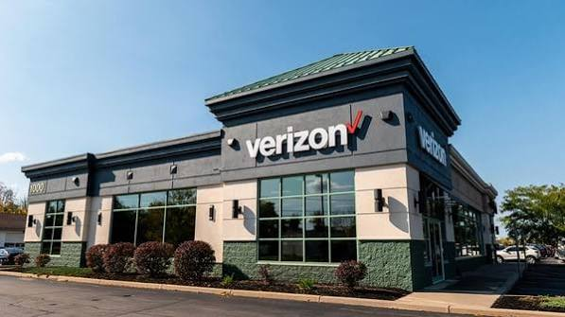
STAKEHOLDER PERSPECTIVES & TRADE-OFFS
Stakeholders: Verizon • Customers • Shareholders • Employees/Retail Partners • Enterprise Customers • Communities • Competitors
What’s at Stake
  Customers: Affordable, reliable service + privacy
  Shareholders: Profitability, dividends + ROI
  Employees/Retail Partners: Job stability + customer traffic
  Enterprise Customers: Reliable connectivity + network performance
  Communities: Broadband access + infrastructure investment
  Competitors: Pricing + network/product pressure
Key Trade-Off
  Growth & broadband investment ↔ Financial discipline & profitability
Potential Benefits
  Targeted marketing • Increased Fios adoption • Customer retention • Better infrastructure decisions • Improved broadband access
Potential Risks
  Privacy concerns • Inaccurate data • Unequal community investment • Cost of expansion
Verizon must balance business growth with customer privacy, financial goals, and equitable broadband access.

